Slide 1
PROJECT 9 / PHASE 2
Deep learning for indoor location prediction
A shared-trunk multitask network compared with the AML Random Forest baseline
Building · Floor · Coordinates
Signal2Space · Krishiv · Gargi · Bhawana · Agrima · Abhiman
Notes:
Phase 2 of Project 9: the deep learning implementation and its fair comparison with the Phase 1 AML baseline.
Viva script:
Krishiv — Opening. Good morning. In Phase 1 we predicted a device's building, floor and position from Wi-Fi signals with three separate Random Forests. In Phase 2 we replaced them with one neural network that has a shared trunk and three heads, and we compared it with the baseline under identical conditions. I'll introduce the problem and the team; each member then presents their part.

Slide 2
What Phase 2 adds
One network predicts all three targets from the same fingerprint the AML models used.
Phase 1 baseline
Same inputs
One network
Fair comparison
three independent Random Forests
same split, same 1,046 train-only features
shared trunk + building, floor and coordinate heads
same 1,111 held-out rows, same metrics
1,046
3 heads
1,111
predictors per scan
on one shared trunk
held-out rows scored once
Coordinates are in the dataset's recorded units throughout: the coordinate reference system is not documented, so errors are not called metres.
Notes:
Phase 2 keeps the Phase 1 data, split and features unchanged and changes only the model, so any difference in results comes from the model.
Viva script:
Krishiv — Problem and scope. Each Wi-Fi scan gives 520 signal-strength readings, and most access points are not detected. Phase 1 used those readings to train three independent Random Forests. The project specification for Phase 2 asks for a shared-trunk multitask network with building, floor and coordinate heads, compared fairly with Phase 1. We kept the same rows, the same 1,046 features and the same metrics, so the comparison isolates the model.

Slide 3
Five workstreams, six pull requests
Each step closed one GitHub issue and merged into main only after its dependencies.
S1 · Gargi
S2 · Bhawana
S3 · Agrima
S4 · Abhiman
S5 · Krishiv
Data contract
data.py, DL_01
Evaluation toolkit
evaluate.py, plots.py
Network + training
model.py, train.py
Runner + ablations
pipeline.py, DL_02–04
Multitask + comparison
multitask.py, DL_05
Merge order S0 (Krishiv: docs, setup, main protection) → S1 and S2 in parallel → S3 → S4 → S5 → S6 team review
20 / 20
10
Identical
tests passing on main
notebooks executed, no errors
metrics on a full second run
Notes:
Work was split into dependency-ordered steps S0 to S5, each delivered as one pull request into main; S6 was the shared review. Issues #15 to #21, pull requests #22 to #27.
Viva script:
Krishiv — Team. I set up the foundation in S0: documentation, contributing rules and the package configuration, and I protected main so every change came through a pull request. Gargi built the data layer, Bhawana the evaluation toolkit, Agrima the network and training loop, and Abhiman the pipeline runner and the single-task experiments. I finished with the multitask evaluation and the comparison with AML.

Slide 4
Evaluation design and held-out boundary
Choose everything on internal validation; read the held-out file only after the choice is saved.
Internal training
Internal validation
Save choice
Held-out
16,085 rows · fit transforms and weights
3,852 rows · early stopping and selection
config + weights written before held-out is read
1,111 rows · scored once
Selection score (lower is better)
S = ⅓ × [ building error rate + floor error rate + mean coordinate error ÷ 125.9 ]
125.9 units is the internal-validation error of always predicting the training centroid, so the coordinate term sits on the same 0–1 scale as the error rates.
Notes:
Same grouped split as Phase 1: GroupShuffleSplit, test size 0.20, seed 42, groups = building, floor, space. The DL code rebuilds this split from the raw CSV and checks it matches row for row.
Viva script:
Krishiv — Evaluation design. We reused the Phase 1 split exactly: 16,085 internal-training rows and 3,852 internal-validation rows from the training file, with the 1,111-row validation file held out. All candidates, early stopping and the final choice used internal validation. The chosen configuration and weights were written to disk before any held-out row was loaded, and the held-out set was then scored once.

Slide 5
Workstream 1 · Reusing the AML feature contract
The network reads exactly the 1,046 columns the Random Forests used.
Load AML tables
Validate contract
Rebuild the split
Fit DL transforms
ML_01 outputs for all three splits
columns, partitions, finite values, binary masks
raw CSV → same 16,085 / 3,852 rows
summary + coordinate scaling, label maps
1,046
≈124 / 67
0
520 scaled RSSI + 520 masks + 6 summaries
coordinate std (units) used for scaling
transforms fitted on held-out rows
Only change from AML: the six summaries are standardized, because counts and dBm values on raw scales slow gradient training.
Notes:
data.py loads the ML_01 feature tables, validates them, rebuilds the split from raw data, and fits the DL-only transforms on internal training. Held-out rows are transformed only.
Viva script:
Gargi — Workstream 1, data contract. Instead of building new features, we reused the Phase 1 tables so the comparison is fair. My module checks the columns, partitions, finite values and binary indicators, confirms the RSSI scaler was fitted on training data only, and rebuilds the grouped split from the raw file to prove the rows match. The network needs inputs on similar scales, so I standardized the six summary columns, and the coordinates, using internal-training statistics only. Identifiers like USERID and PHONEID stay out of the inputs.

Slide 6
Workstream 1 · What the held-out file really tests
A later campaign with mostly new phones, in the same three buildings.
Held-out (1,111 rows)
Internal validation (3,852 rows)
0
26
156
1,428
identical fingerprints
rows on an exact training position
identical fingerprints
rows on an exact training position
9 / 11
+3 months
Same
phones never seen in training
Sep–Oct vs May–Jun 2013
users, phones and period
Even with disjoint building-floor-space groups, internal validation is much closer to training, so its scores are optimistic.
USERID is a placeholder (0) for every held-out row.
Notes:
Descriptive checks from DL_01 (dl_01_partition_overlap.csv and dl_01_partition_identity_summary.csv). None of these were used for fitting.
Viva script:
Gargi — Workstream 1, partitions. These checks explain why held-out scores are lower than internal ones. The held-out file shares no identical fingerprint with training, was collected about three months later, and 9 of its 11 phones never appear in training. Its USERID is a placeholder. Internal validation is easier: it shares users, phones and many exact positions with training. So internal scores are optimistic, and the held-out score is the honest one.

Slide 7
Workstream 2 · One evaluation toolkit for every model
Same metrics, same columns, same rows for AML and both DL models.
Classification
Coordinates
Confusion matrices
accuracy and macro F1 for building and floor
MAE per axis; mean, median, p75, p95 Euclidean error
rows = actual, AML layout, DL vs AML side by side
Hierarchy
Paired tests
Robustness
both correct · floor wrong · building wrong · both wrong
exact McNemar; bootstrap 95% CI on error difference
per-phone and per-user results, post hoc only
Joined on (SOURCE_PARTITION, ROW_ID), because ROW_ID restarts in each source file.
Notes:
evaluate.py and plots.py. Prediction tables use the AML ML_05 column names so DL and AML predictions join on (SOURCE_PARTITION, ROW_ID).
Viva script:
Bhawana — Workstream 2, evaluation. A fair comparison needs identical measurement, so I built one toolkit that every notebook uses. It computes accuracy and macro F1, per-axis MAE and Euclidean error, confusion matrices, the hierarchical building-floor breakdown and per-phone robustness. It also runs paired tests: McNemar for correctness and a bootstrap interval for coordinate error, so we can say whether a difference is real. Its prediction tables use the same columns as the AML outputs, so rows line up exactly.

Slide 8
Workstream 3 · Shared-trunk multitask network
Three heads read one 256-unit representation of the fingerprint.
1,046 predictors
RSSI + presence masks + summaries
768,906
trainable parameters
Shared trunk · 512
Linear · BatchNorm · ReLU · Dropout 0.3
~40 s
Shared trunk · 256
Linear · BatchNorm · ReLU · Dropout 0.3
to train on a 4-core CPU
No rule forces building and floor to agree. The hierarchical analysis later measures how often they disagree.
Building head
128 → 3 logits
Floor head
128 → 5 logits
Coordinate head
128 → 2 values
Notes:
model.py. Selected configuration: trunk 1,046 → 512 → 256 with BatchNorm, ReLU and dropout 0.3 (input dropout 0.1); each head is Linear(256, 128) → ReLU → output. 768,906 parameters.
Viva script:
Agrima — Workstream 3, architecture. The network has a shared trunk: two layers that turn the 1,046 inputs into a 256-number summary of the fingerprint. Three small heads read that same summary: one outputs building scores, one floor scores, and one the two coordinates. Because all three heads train the same trunk, what one task learns can help the others. Building and floor are predicted independently, without a rule forcing them to agree.

Slide 9
Workstream 3 · Loss and training
A weighted sum of three task losses, trained with early stopping.
L = w_b · CE(building) + w_f · CE(floor) + w_c · SmoothL1_β(coordinates)
Optimizer AdamW · lr 0.001 · weight decay 0.0001
Batch 256 rows, seeded shuffle
Schedule halve lr after 5 stalled epochs
Stopping max 150 epochs · patience 15 · best weights restored
Reproducible seed 42 · deterministic PyTorch
Lower is better. β = 0.1 became the default; a β = 1 candidate stays in the selection grid.
Notes:
train.py. Loss = w_b·CE(building) + w_f·CE(floor) + w_c·SmoothL1_beta(coordinates). Beta check on internal validation, 512-256 trunk, 60 epochs: scores 0.0430 (beta 1.0), 0.0355 (0.1), 0.0378 (0.02).
Viva script:
Agrima — Workstream 3, training. The loss adds the three task losses with weights. For coordinates we used Smooth-L1. With its default setting, errors smaller than one standard deviation, about 70 to 120 units, get tiny gradients, so position never sharpens. A quick check on internal validation showed beta 0.1 works best, so that became the default. Training uses AdamW, halves the learning rate when progress stalls, and stops after 15 epochs without improvement, restoring the best weights. Everything is seeded, and a full rerun reproduced every number.

Slide 10
Workstream 3 · Choosing among seven candidates
The smallest trunk, with coordinate loss weighted twice, scored best.
97.87%
internal floor accuracy
10.28
internal mean error (units)
Epoch 25
best of 40 epochs run
Notes:
dl_05_multitask_selection.csv. Candidates vary trunk size, dropout, loss weights and beta. Only internal validation was used.
Viva script:
Agrima — Workstream 3, selection. We trained seven candidates that vary trunk size, dropout, loss weights and beta. The winner uses the small 512-256 trunk with the coordinate loss weighted twice. Bigger trunks did not help, and heavier dropout hurt floor accuracy. On internal validation the winner reaches 97.87% floor accuracy and a mean coordinate error of 10.28 units.

Slide 11
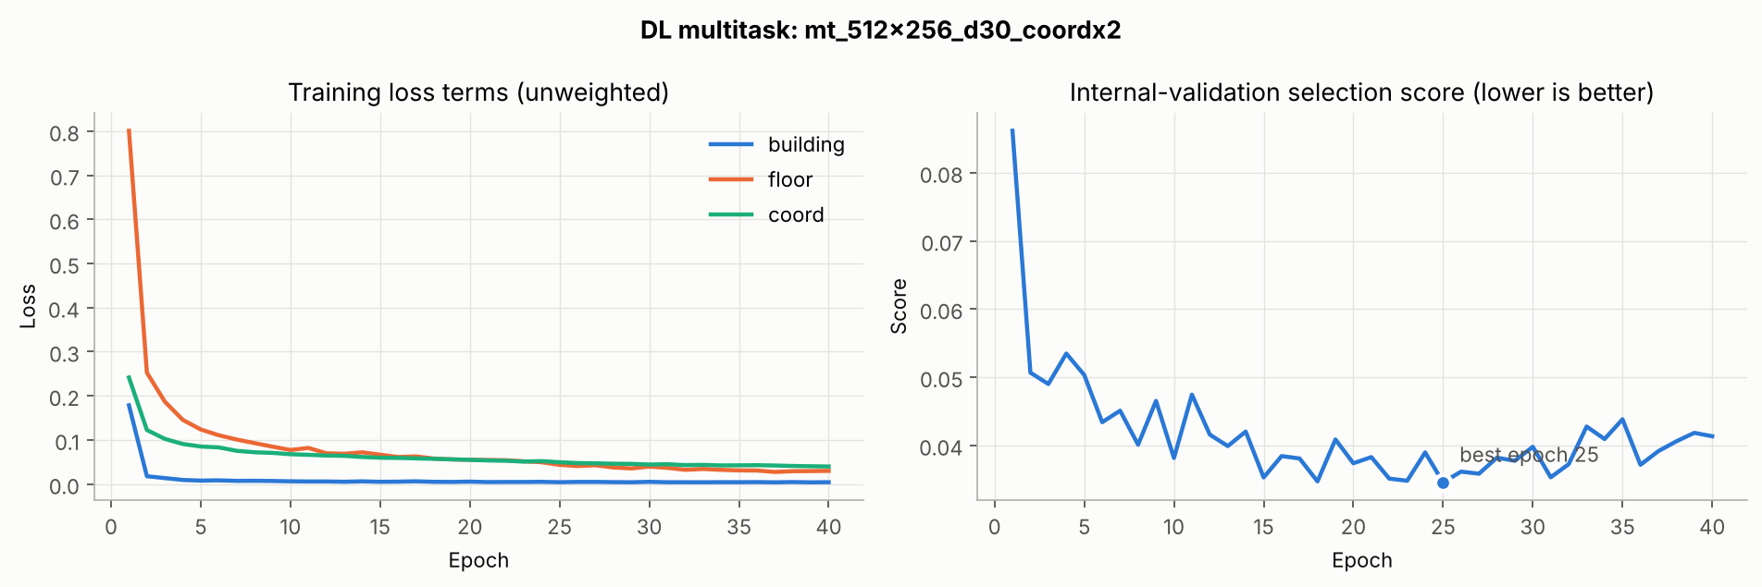
Workstream 3 · Training history
Early stopping restored epoch 25 after 15 epochs without improvement.
Training losses keep falling after epoch 25, but the validation score does not improve, so later epochs would only fit the training campaign more closely.
Notes:
dl_05_multitask_training_history.png. Left: unweighted training loss terms. Right: internal-validation selection score per epoch.
Viva script:
Agrima — Workstream 3, training curves. On the left, all three losses fall steadily. On the right is the score we select on. It reaches its best at epoch 25, then stops improving; after 15 more epochs training stops and the epoch-25 weights are restored. That protects us from overfitting the training campaign.

Slide 12
Workstream 4 · Runner and single-task ablations
Same trunk family, one head each: does sharing help each task?
Network | Selected trunk | Best epoch | Held-out result
Building only (DL_02) | 512-256 (all tied at 99.95%) | 11 | 99.73% accuracy
Floor only (DL_03) | 1024-512-256 | 15 | 90.28% accuracy
Coordinates only (DL_04) | 1024-512 | 100 | 9.84 mean error
9.84
single-task mean error (units)
vs 11.58
AML Random Forest
One command runs every stage:
PYTHONPATH=src python -m signal2space_dl.pipeline --stage all
About 18 minutes on a 4-core CPU. --quick runs a smoke test.
Notes:
pipeline.py runs every stage from one command: PYTHONPATH=src python -m signal2space_dl.pipeline --stage all. DL_02 to DL_04 train single-task networks over four trunk candidates each.
Viva script:
Abhiman — Workstream 4. I wrote the runner that executes the whole DL workflow from one command, and the three single-task notebooks. Each trains a network of the same family with only one head, choosing its trunk on internal validation and saving the choice before scoring the held-out set. These ablations tell us whether sharing a trunk helps each task. The coordinate-only network turned out to be the most accurate position model in the project.

Slide 13
Workstream 5 · Held-out classification
The multitask network is the best floor and joint classifier.
+1.71 pp
floor accuracy over AML
p = 0.014
paired McNemar, 37 vs 18 rows
Single-task DL has no joint value: its building and floor come from different networks. The axis starts at 80%.
Notes:
Held-out, 1,111 identical rows. Building: AML 99.73%, multitask 99.91%, single 99.73%. Floor: 88.93%, 90.64%, 90.28%. Joint building and floor: 88.75%, 90.64%, not defined for single-task.
Viva script:
Krishiv — Workstream 5, classification. All three models are scored on the same 1,111 held-out rows. Building is near perfect for everyone. On floor, the multitask network reaches 90.64% against 88.93% for the Random Forest, and joint building-and-floor accuracy rises from 88.75% to 90.64%. On paired rows, the multitask model fixes 37 floor errors the baseline makes and introduces 18; the exact McNemar p-value is 0.014, so this is a real improvement.

Slide 14
Workstream 5 · Held-out coordinates
Sharing the trunk costs position accuracy; the dedicated network wins.
9.84
best mean error: single-task
+0.30
multitask − AML, mean error
95% bootstrap interval −0.42 to +1.02 includes zero: no real difference between multitask and AML.
Notes:
Held-out coordinate errors in recorded units. AML: MAE 8.10 / 6.81, mean 11.58, median 7.49. Multitask: 8.55 / 6.65, 11.88, 9.80. Single-task: 6.76 / 5.83, 9.84, 7.59. Paired mean difference DL multitask minus AML: +0.30, 95% bootstrap CI -0.42 to 1.02.
Viva script:
Krishiv — Workstream 5, coordinates. Coordinates tell a different story. The multitask head's mean error, 11.88 units, is statistically the same as the Random Forest's 11.58: the confidence interval of the difference includes zero. The coordinate-only network from Abhiman's workstream is clearly best at 9.84. So sharing a trunk helps the floor task but costs position accuracy.

Slide 15
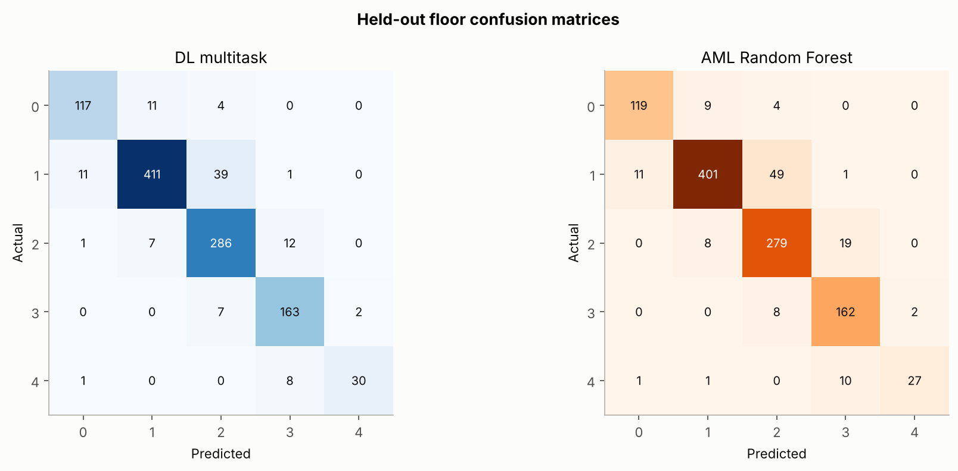
Workstream 5 · Floor confusion matrices
Gains come from the floors the baseline found hardest.
76.9%
floor 4 recall (AML 69.2%)
39 vs 49
floor 1 → floor 2 errors
97 / 103
floor errors off by one floor
Hardest cell for both: building 1, floor 1 (DL 70.6%, AML 65.7%).
Notes:
dl_05_multitask_heldout_floor_confusion_dl_vs_aml.png. Held-out recall AML to DL: floor 0 90.15 to 88.64, floor 1 86.80 to 88.96, floor 2 91.18 to 93.46, floor 3 94.19 to 94.77, floor 4 69.23 to 76.92.
Viva script:
Krishiv — Workstream 5, floor errors. The multitask network improves recall on four of five floors, most on floor 4, which has only 39 held-out rows. The most common error for both models is floor 1 predicted as floor 2, but it falls from 49 to 39 rows. Almost all remaining errors are one floor away: 97 of 103 among rows with the correct building.

Slide 16
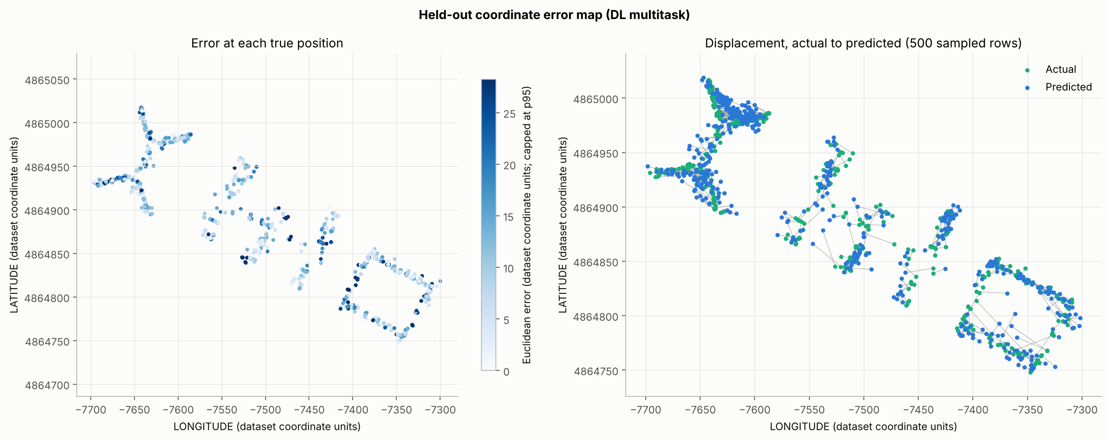
Workstream 5 · Where coordinate errors occur
Fewer tiny errors than AML, but a much lighter tail.
28.2
p95 error (AML 36.2)
66.6
largest error (AML 135.1)
18% / 33%
errors < 5 units, DL / AML
Mean error by building: DL 11.5 · 12.0 · 12.5; AML 8.0 · 14.6 · 15.4.
Notes:
dl_05_multitask_heldout_error_map.png. Share of errors below 5 units: AML 32.8%, DL 18.3%. 95th percentile: AML 36.21, DL 28.24. Maximum: AML 135.1, DL 66.6. Mean error by building, DL: 11.47, 12.01, 12.54; AML: 7.97, 14.60, 15.35.
Viva script:
Krishiv — Workstream 5, error map. Errors are scattered rather than a uniform offset. The two models fail differently. The Random Forest places a third of rows within 5 units, which is why its median is lower, but it also makes some very large errors, up to 135 units. The multitask network rarely lands that close, but its worst error is half as large and its 95th percentile is 28 against 36. It is also even across buildings, while the Random Forest is much better in building 0 than in buildings 1 and 2.

Slide 17
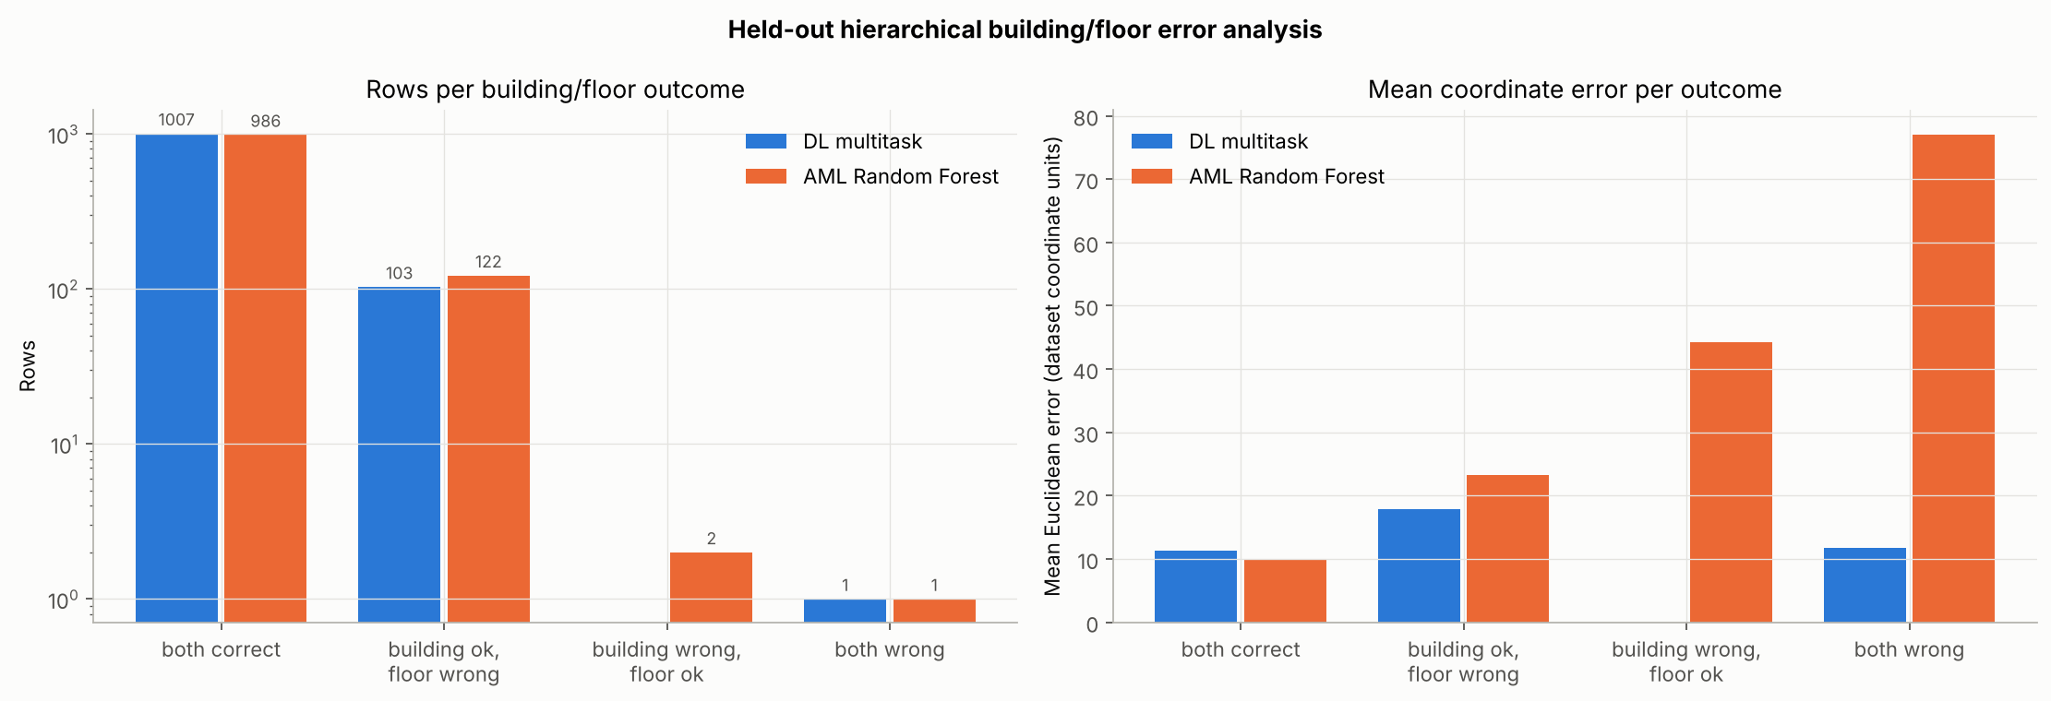
Workstream 5 · Hierarchical error analysis
When the floor is wrong, the multitask position degrades far less.
1,007
17.9
0
When both are correct, AML is more precise (10.0 vs 11.3 units).
both correct (AML 986)
error when floor wrong (AML 23.3)
wrong building, right floor (AML 2)
Notes:
dl_05_multitask_hierarchical_dl_vs_aml.png. Rows AML / DL: both correct 986 / 1,007; floor wrong 122 / 103; building wrong floor right 2 / 0; both wrong 1 / 1. Mean coordinate error AML / DL: 10.00 / 11.27; 23.27 / 17.88; 44.31 / none; 77.04 / 11.74.
Viva script:
Krishiv — Workstream 5, hierarchy. Here we group rows by whether building and floor are right. The multitask model has 21 more rows with both correct and never gets the building wrong with the right floor. The interesting part is the right panel: when the floor is wrong, the Random Forest's position error more than doubles, to 23.3 units, while the multitask network's rises only to 17.9. Its position stays consistent with its floor guess, which is what a shared representation should give.

Slide 18
Workstream 5 · Is the gain robust?
Every training seed beats the baseline on floor accuracy.
90.13%
0.50 pp
mean over 3 seeds
standard deviation
By phone (post hoc)
Phone 13 (seen, 369 rows) 93.5%
Phone 20 (unseen, 213 rows) 90.1%
Unseen phones, range 76.5–95.0%
The axis starts at 85%. Coordinate error over seeds (11.88–12.40) never beats AML's 11.58.
Notes:
dl_05_multitask_seed_variability.csv: frozen configuration retrained with seeds 42, 7 and 2026, no re-selection. Floor 90.64, 89.65, 90.10 (mean 90.13, SD 0.50 pp). Mean error 11.88, 12.40, 11.94. Phone breakdown: dl_05_multitask_robustness_by_identifier.csv.
Viva script:
Krishiv — Workstream 5, robustness. To check the floor gain is not luck, we retrained the frozen configuration with two more seeds. All three beat the baseline's 88.93%, averaging 90.13%. Coordinate error never beats the baseline. By phone, the one phone shared with training reaches 93.5%; unseen phones range from 76.5% to 95%. Those groups are small and tied to particular times and places, so we treat them as descriptive.

Slide 19
What sharing a trunk does
It helps the classification tasks and costs position accuracy.
Building
Floor
Coordinates
At ceiling
Helped
Hurt
≥ 99.7% for every model; differences of 1–3 rows are not significant (p = 0.63).
Best classifier: 90.64% vs 88.93%, significant (p = 0.014) and stable across seeds.
Multitask equals AML; the single-task network is best (9.84 vs 11.58 units).
Use the multitask network when one model must return building, floor and position together. Use the coordinate network when position precision matters most.
Notes:
Summary of the comparison across tasks.
Viva script:
Krishiv — Interpretation. Building is at the ceiling for every model, so it cannot separate them. Floor benefits from sharing: the multitask network is the best floor classifier and the gain is significant and stable. Coordinates suffer: the shared 256-unit representation is pulled toward separating floors, so a dedicated coordinate network is clearly better. In practice: use the multitask network when one model must return building, floor and position together, and the coordinate network when position precision matters most.

Slide 20
Limitations
What these results do not establish.
Same buildings only
Recorded units
Small search
The held-out file is a later campaign with new phones, not unseen buildings.
The coordinate system is undocumented, so errors are not verified metres.
7 multitask and 4 single-task candidates; one seed during selection.
Optimistic validation
Independent heads
Specification copy
Internal validation shares users, phones, period and positions with training.
No rule forces a valid building-floor pair or a position inside the building.
The specification PDF was unavailable to the implementer; its stated requirements were followed.
Notes:
Full list in reports/DL_Project_Report.pdf, Section VII, and docs/DL_PIPELINE.md.
Viva script:
Krishiv — Limitations. Results describe this dataset's split: a later campaign in the same buildings, not new buildings. Coordinates are in recorded units because the coordinate system isn't documented. Our search grids were small so they could run on a CPU, and selection used one seed. Internal validation is optimistic because it overlaps heavily with training. And the heads are independent, so nothing forces building, floor and position to agree.

Slide 21
Conclusion
One shared network improves floor prediction under identical conditions.
99.91%
90.64%
9.84
building accuracy (AML 99.73%)
floor accuracy (AML 88.93%)
best mean error, single-task (AML 11.58)
What the project establishes
Next steps
A fair, reproducible comparison: the shared trunk is the best building-and-floor model on this split, and a dedicated network is the best position model.
Constrain the heads so building, floor and position agree; weight the coordinate head per building; test on a split with unseen positions.
Notes:
Every number reproduces from the repository: notebooks DL_01 to DL_05, models in models/dl, tables in data/tables.
Viva script:
Krishiv — Conclusion. Under identical data, features, split and metrics, the shared-trunk network raises held-out floor accuracy from 88.93 to 90.64 percent and joint accuracy from 88.75 to 90.64 percent. Its coordinate error matches the baseline, and a dedicated coordinate network does better at 9.84 units. Everything is reproducible from the repository with one command. Thank you; we're happy to take questions.

Slide 22
References
Dataset, methods and project sources.
[1] UJIIndoorLoc dataset
UCI Machine Learning Repository, dataset 310. doi: 10.24432/C5MS59
[2] Dataset paper
J. Torres-Sospedra et al., “UJIIndoorLoc: A new multi-building and multi-floor database for WLAN fingerprint-based indoor localization problems,” IPIN 2014, pp. 261–270.
[3] Multitask learning
R. Caruana, “Multitask learning,” Machine Learning, vol. 28, pp. 41–75, 1997.
[4] CNN localization on UJIIndoorLoc
X. Song et al., “A novel convolutional neural network based indoor localization framework with WiFi fingerprinting,” IEEE Access, vol. 7, 2019.
[5] Project implementation
github.com/krishiv274/Signal2Space · DL_01–DL_05 notebooks, src/signal2space_dl, models/dl, data/tables.
Notes:
References as in the DL report bibliography.
Viva script:
Krishiv — References. These are the dataset, the methods we built on, and our repository, where every result can be reproduced.

Slide 23
Thank you
Questions
Indoor Location Prediction Using Wi-Fi Signals · Phase 2: Deep Learning
Notes:
Closing slide.
Viva script:
Krishiv — Thank you. We're happy to take questions; each member can answer on their own workstream.

